Slide 1

NGULAR
Özgür Kaplan
ozgur.Kaplan@kocsistem.com.tr

Slide 2
Angular Is…
A JavaScript framework
For building client-side applications
Using HTML, CSS and JavaScript

Slide 3
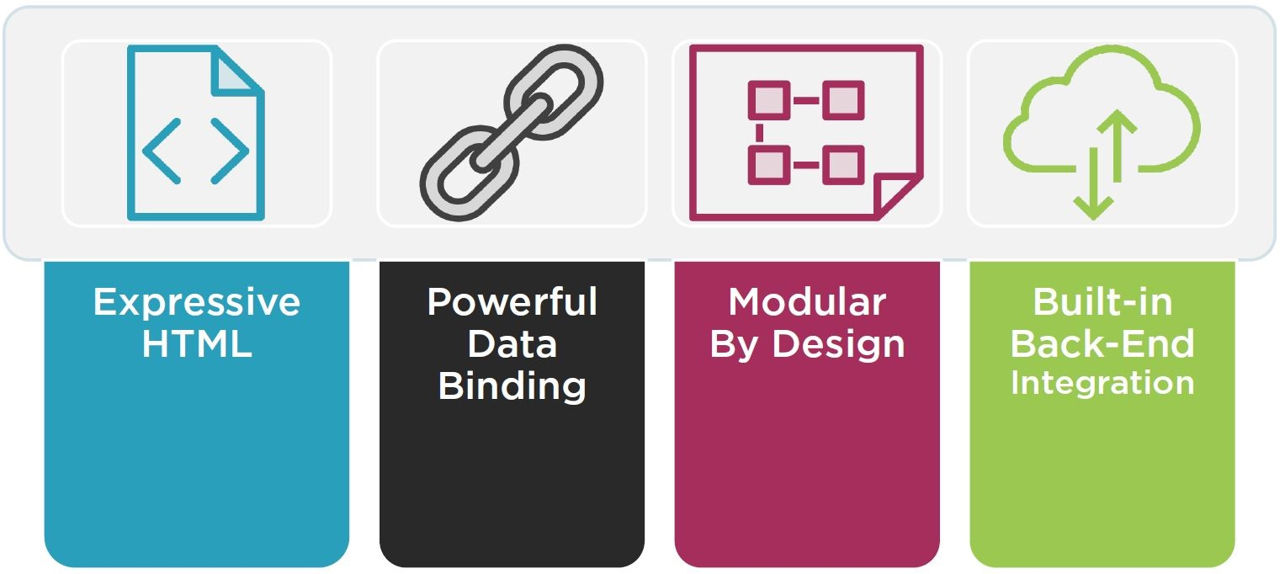
Why Angular?
Notes:
Expressive HTML -> If condition, for loop, loal variable
Powerful Data Binding -> Display field from data model, track changes, process update from user
Modular By Design -> Set of building blocks, create and reuse content
Build-in Back-End Integration -> Get, Post Data, Execute server side business data

Slide 4
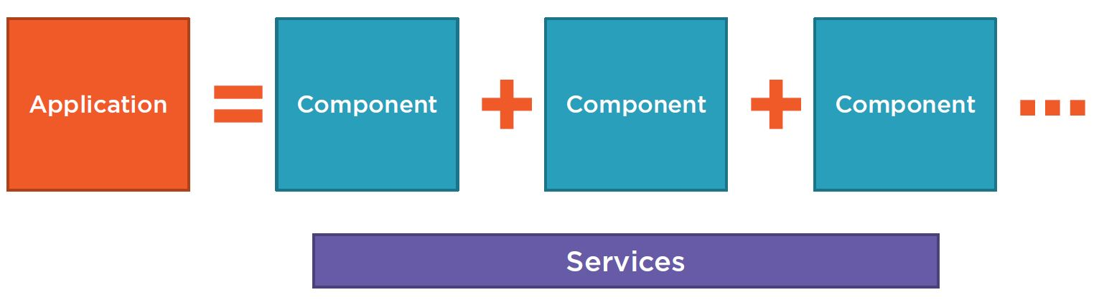
Anatomy of an Angular Application
Notes:
Application = set of companents
Services provides functionality across components

Slide 5
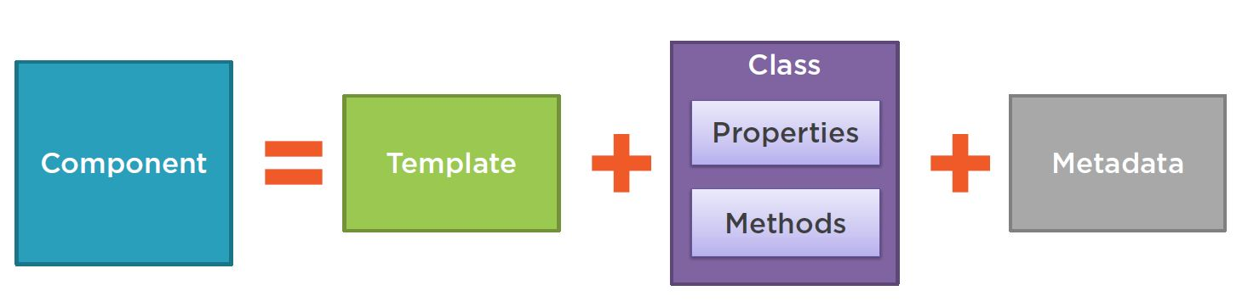
Component
Notes:
Template = HTML
Properties = Data elements to use in view
Methods = events
Metadata = Additional information and Identifies class as an angular components

Slide 6
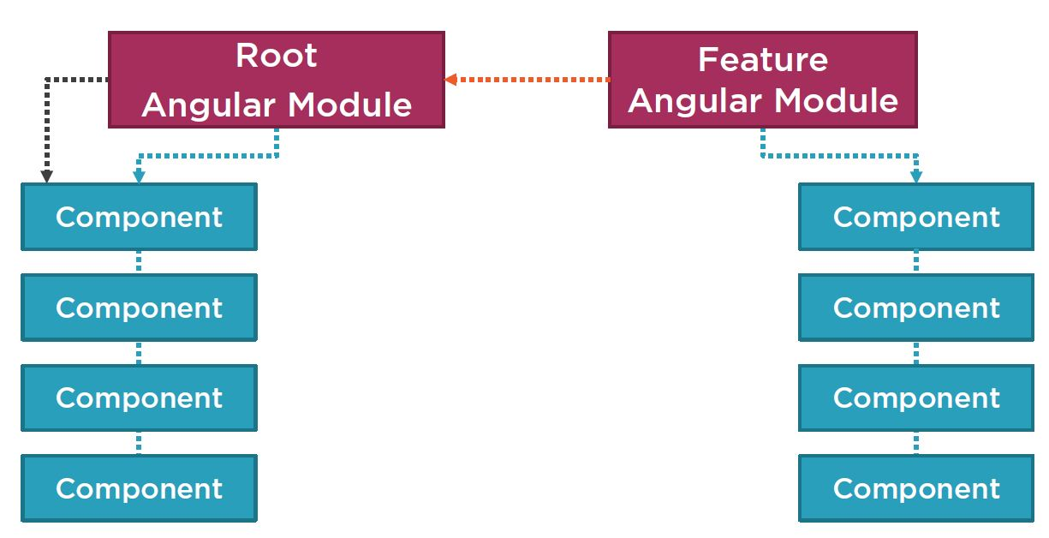
Angular Modules

Slide 7
Development Environment
Node.js https://nodejs.org/en/
IDE
VS Code https://code.visualstudio.com/
WebStorm https://www.jetbrains.com/webstorm/
Atom https://atom.io/
VS https://visualstudio.microsoft.com/
Angular CLI https://cli.angular.io/
JSON Server https://github.com/typicode/json-server
GIT https://git-scm.com/

Slide 8
Angular CLI
https://cli.angular.io/
npm install -g @angular/cli
ng new my-dream-app
cd my-dream-app
ng serve
https://github.com/angular/angular-cli/wiki

Slide 9
JSON Server
https://github.com/typicode/json-server
npm install -g json-server
Create a db.json file with some data
json-server --watch db.json

Slide 10
What are we building?
https://github.com/ozgurkaplan/KocAkademiAngularStarter
git clone https://github.com/ozgurkaplan/KocAkademiAngularStarter.git
run json.server.bat
cd ks-overflow-app – Refactored
npm-install
ng serve
http://localhost:4200/

Slide 11
Starting A New Project
ng new ks-overflow-app
cd ks-overflow-app
ng serve
Importat Folder and Files
packages.json
node_modules
.angular-cli.json
src/app/app.module.ts
src/app/app.component.ts

Slide 12
Installing Bootstrap
npm install bootstrap@latest --save-dev
styles.css
@import "~bootstrap/dist/css/bootstrap.css";
https://getbootstrap.com/docs/4.1/examples/ (Starter Template)
Layout?
Routing?
Login Page?

Slide 13
Home Page & Login Page
cd src/app
ng generate component Login
https://getbootstrap.com/docs/4.1/examples/ (Signin)
mkdir question
mkdir user
cd question
ng generate component QuestionList
ng generate component QuestionDetail
cd ../user
ng generate component Profile

Slide 14
Layout and Routing
RouterModule
import { RouterModule } from '@angular/router';
<router-outlet></router-outlet>
RouterModule.forRoot([
{ path: 'question/list', component: QuestionListComponent },
{ path: 'question/ask', component: QuestionAskComponent },
{ path: 'question/detail', component: QuestionDetailComponent },
{ path: 'login', component: LoginComponent },
])
http://localhost:4200/question/list
http://localhost:4200/login
http://localhost:4200/
How can we make a common layout for QuestionList & QustionAsk and UserProfile pages?
[routerLink]

Slide 15
Layout Component
ng generate component Layout
RouterModule.forRoot([
//Site routes goes here
{
path: '',
component: LayoutComponent,
children: [
{ path: '', component: QuestionListComponent, pathMatch: 'full' },
{ path: 'profile', component: ProfileComponent, pathMatch: 'full' },
{ path: 'question/ask', component: QuestionAskComponent, pathMatch: 'full' },
{ path: 'question/detail/:id', component: QuestionDetailComponent}
]
},
//no layout routes
{ path: 'login', component: LoginComponent },
])

Slide 16
Login
MVVM
[(ngModel)]
Constructor Injection
Event Handling
Services
Local Storage
HTTP calls
Observable

Slide 17
Protecting Pages
Guards
AuthPipe
Ng generate guard Auth
canActivate

Slide 18
Question List – Detail - Ask
ngFor
ngIf
Oneway binding
ngOnInit
Observable.combineLates
utility.ts export function
Class
ActivatedRoute

Slide 19
Refactoring
Split application into multiple Modules
QuestionModule
UserModule
SharedModule
MenuComponent

